Slide 1

CAR PRICE PREDICTION
Presented By:
NITISH KUMAR SHARMA

Slide 2
PROBLEM STATEMENT
With the covid 19 impact in the market, we have seen lot of changes in the car market. Now some cars are in demand hence making them costly and some are not in demand hence cheaper.
One of our clients works with small traders, who sell used cars. With the change in market due to covid 19 impact, our client is facing problems with their previous car price valuation machine learning models.
So, they are looking for new machine learning models from new data. We have to make a car price valuation model.

Slide 3
EDA STEPS
We will start by importing the libraries that we require for performing EDA. These include NumPy for mathematic computation, Pandas for handling dataset, Matplotlib, and Seaborn for visualization. Then different regression models from sklearn for model building.
We will now read the data from CSV files into a Pandas DataFrame.
We will display top 5 rows by using .head() function to know if it has the right type to data in it or not.
Using .shape function to display total number of rows and columns present in the dataset.
Using .columns function to display all the features name present in the dataset.
We will now check datatype of each variables in data by using .info() function.
We will now display number of unique values in each features by using .nunique() function.

Slide 4
Then listing out categorical and continuous features from dataset.
Use describe() function to get statistical details like count, percentiles, mean, std, and maximum value of data.
Observed that mileage, power and torque variables were having zero values in minimum which is not possible. So filled the values with their respective median values.
We will now check for null values in the dataset. We will use isnull().sum() function. Dataset has null values, so we will the fill the null values using median.
Appending all the duplicates values into one to optimize result and for better visualization experience.
Now we will do univariate, bivariate analysis on the data to extract meaningful informations from it.

Slide 5
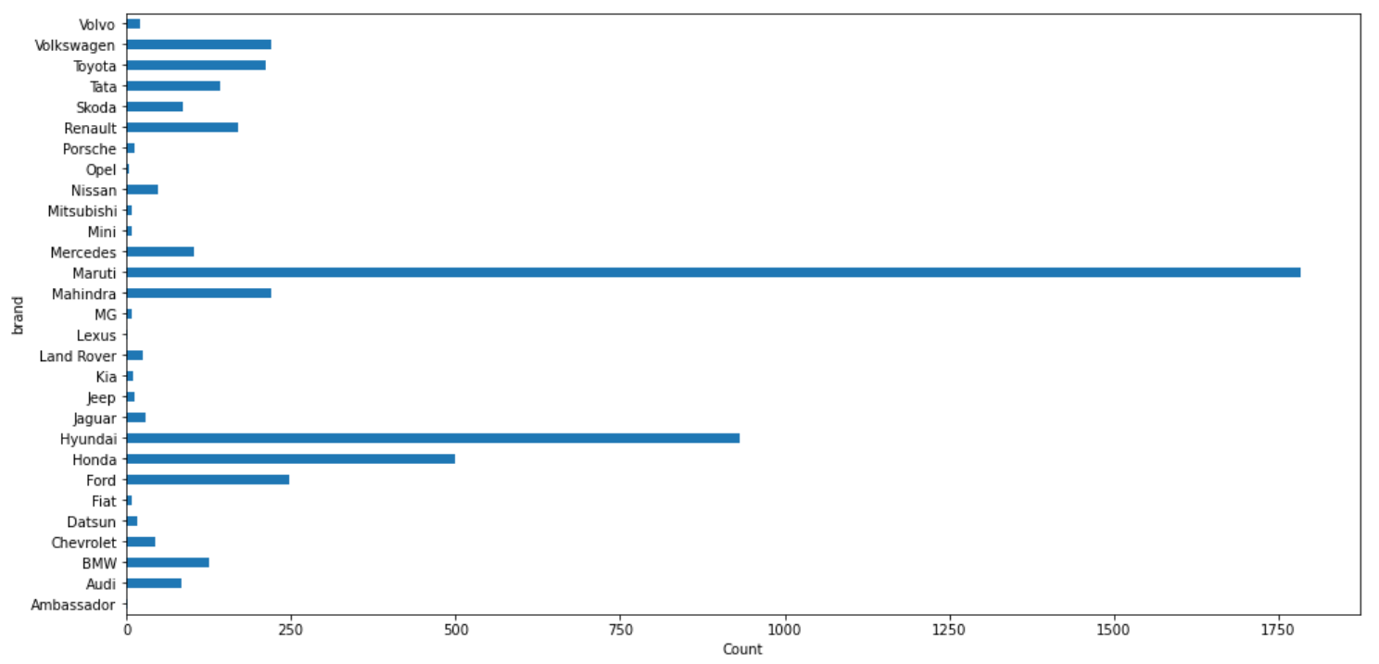
VISUALIZATIONS
Maruti brand type of used cars is present in maximum number than any other.

Slide 6
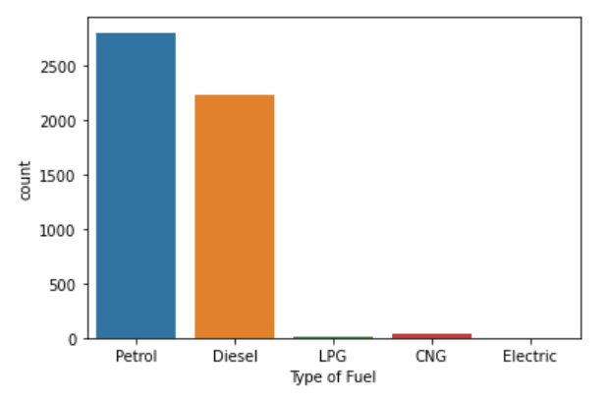
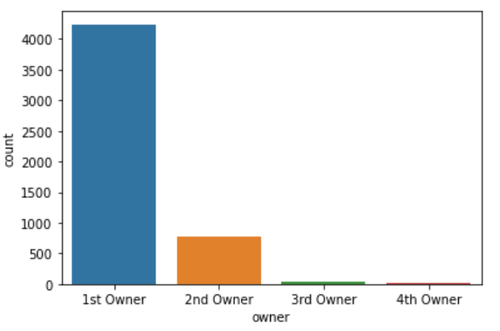
Mostly used cars in the data is having petrol type of fuel then followed by diesel.
Above plot shows that used cars have maximum only one owner.

Slide 7
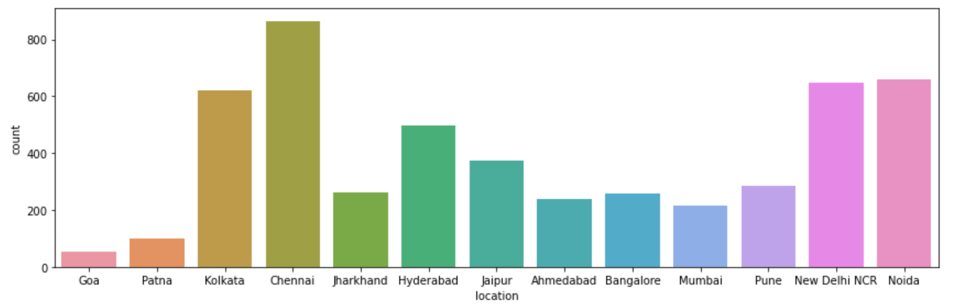
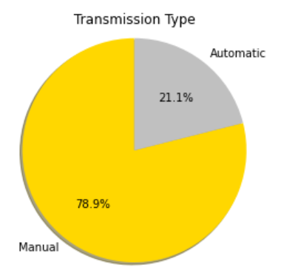
Around 79% of used cars are of Manual type and rest 21% are of Automatic type.
Maximum used cars data have been scraped from chennai location.

Slide 8
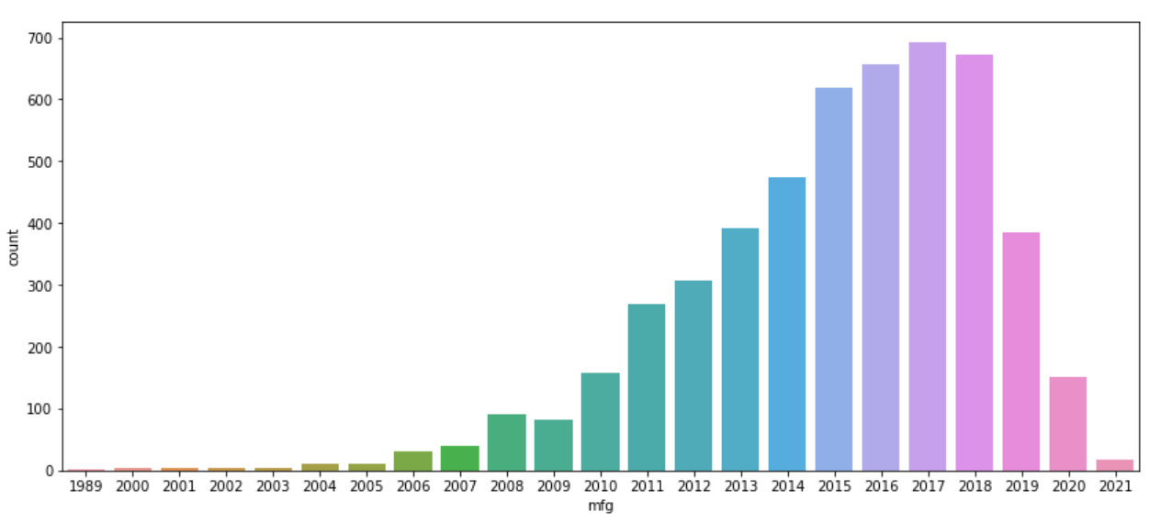
Mostly the used cars make year lies between 2015-2018.

Slide 9
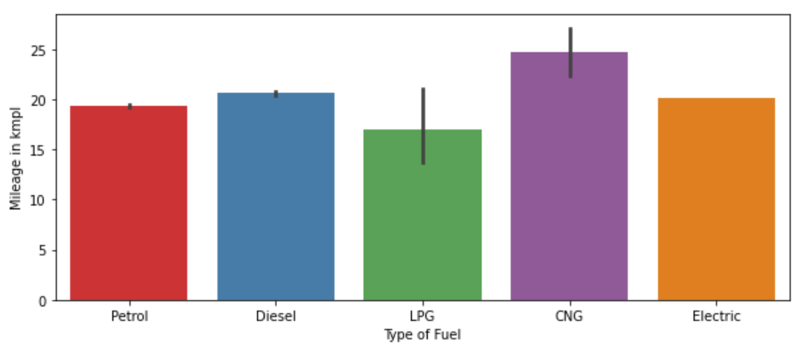
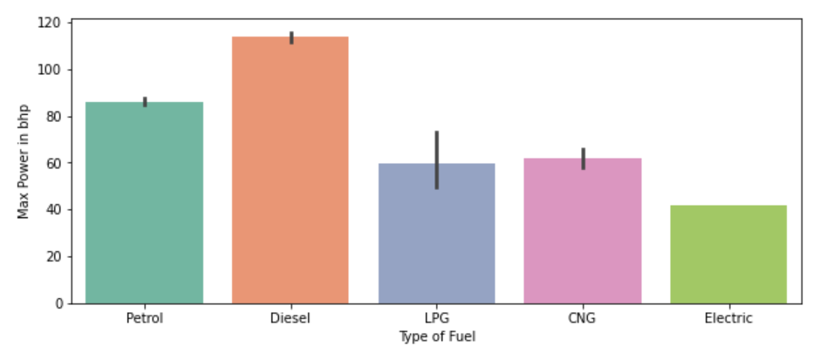
CNG fuel gives more mileage than other fuels.
Diesel fuel gives maximum power to cars than any other fuels.

Slide 10
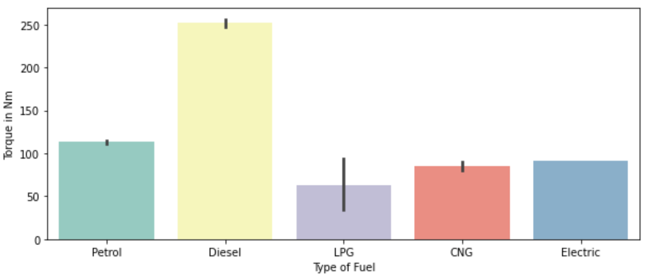
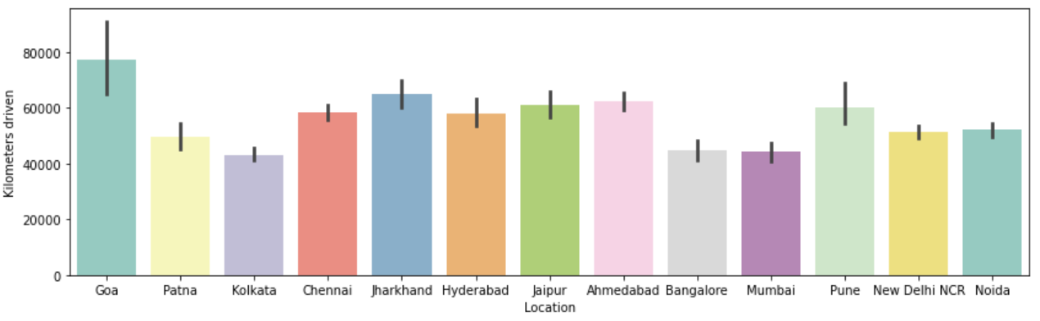
Diesel fuel provides maximum torque to cars than any other fuels.
Maximum kilometers driven used cars is from Goa location.

Slide 11
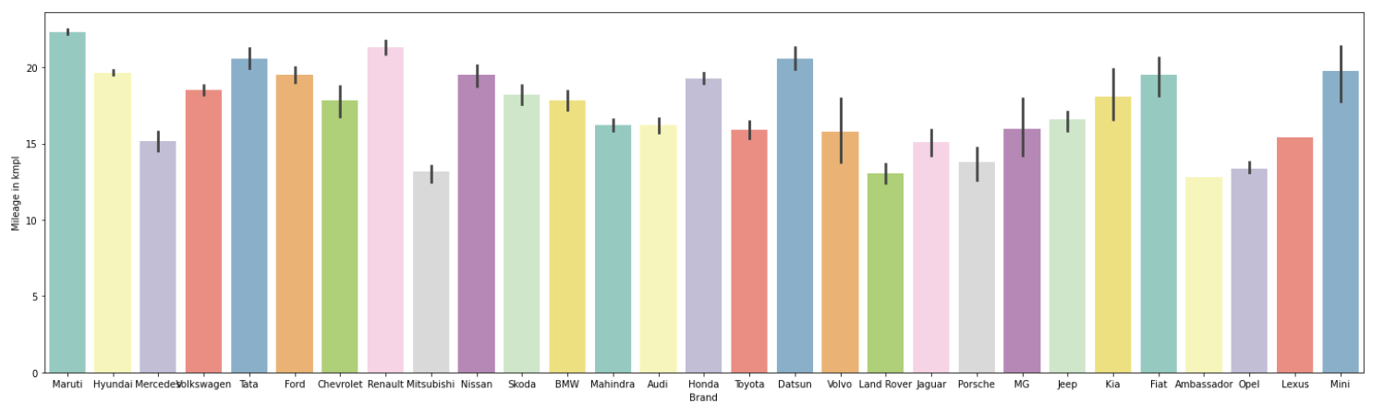
Maruti gives above 20kmpl mileage. Rest all Tata, Renault, Hyundai, Datsun, Ford, Honda, Nissan, Fiat type of used cars gives mileage between (17-20)kmpl.

Slide 12
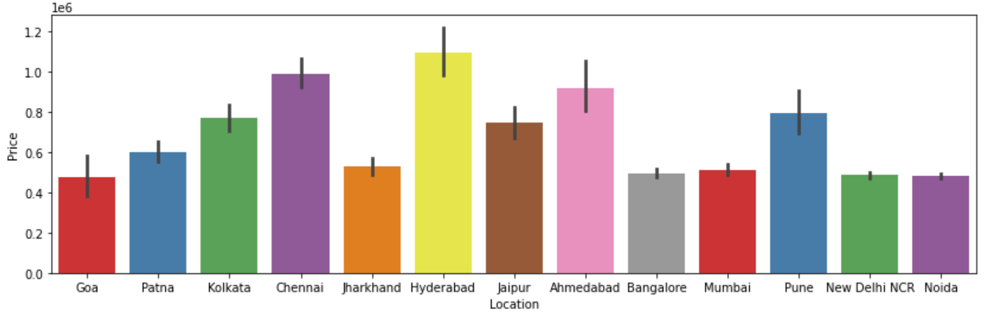
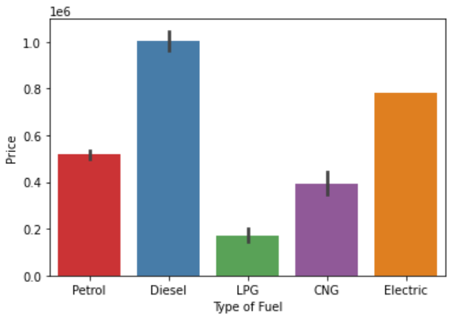
Price of used cars is maximum in Hyderabad and least in Goa.
Diesel used cars price is high than others.

Slide 13
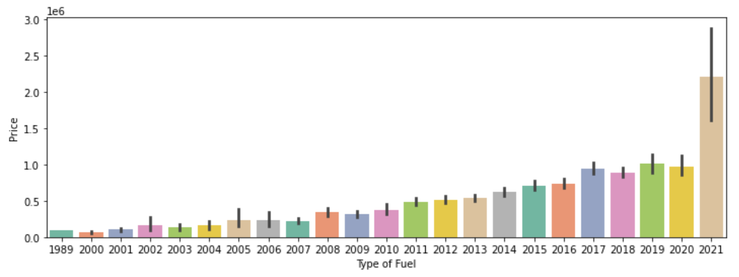
Older manufacturing date used cars price decreases, whereas used cars with newer manufacturing date price increases.

Slide 14
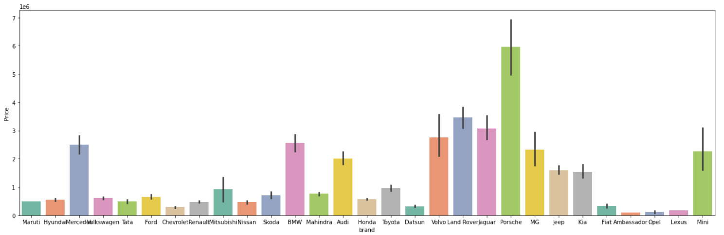
Used cars of Porsche brand has maximum price than other brand of cars.

Slide 15
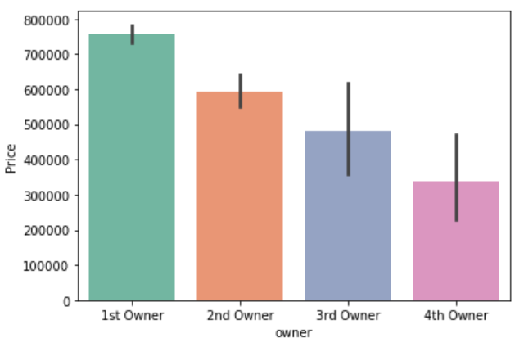
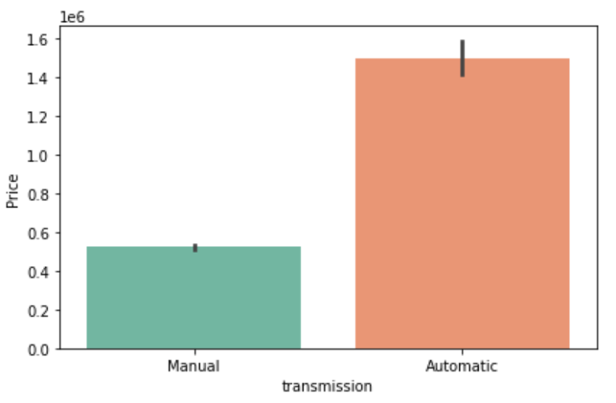
More the number of owners of car, lesser will be its price.
Automatic type of used cars price is very much high than manual ones.

Slide 16
STEPS & ASSUMPTIONS TAKEN
After data cleaning, visualized the variables using boxplot and the variables were having outliers.
So treated the variables using 1.5 IQR method to remove outliers.
Used label encoder to convert categorical variables of the data into machine language.
Plotted heat map to see the correlation of independent variables with the target (Price) variable.
Then removed variables from the data that were highly co-related to each other by observing it through variance inflation factor.
Then started model building and testing with different algorithms to find best model and finally doing hyper parameter tuning to achieve good accuracy.

Slide 17
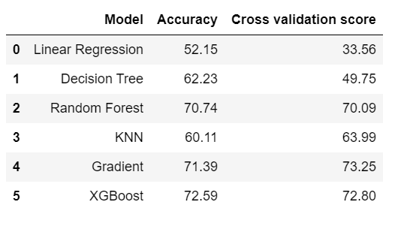
FINALIZED MODEL
XGB Regressor is our best/finalized model because the difference between its accuracy and CV score is least among all models.
After applying hyper parameter tuning on our best model (XGB Regressor) , the accuracy increased by 3.68%.

Slide 18
CONCLUSION
The analysis showed that engine, maximum power and torque variables were important determinants of target (Price) variable for used cars.
In the car market, mostly used cars available are of petrol & diesel type variant.
Used cars were having first owner maximum.
Mostly used cars make year was between 2015-2018.
In terms of mileage, CNG is better than other fuels.
Diesel used cars price is high and provides maximum power & torque than any other fuels.
Automatic transmission type of used cars price is very much high than compared to manual ones.
Used cars of Hyderabad was very high in price compared to New Delhi, Noida and Goa were price was least.
Kilometers driven column gives the idea about the used car overall condition and maintainance.
Porsche brand of used cars have maximum price than any other car brands.

Slide 19
THANK YOU!

